Slide 1
Data Consumption board on Polly
Abhimanyu Mandal
15/07/2022

Slide 2
Agenda
Overview of modules
Detailed explanation of each modules:
Stat overview and counter module
Audit module
Plotter module
Generate report module
Acknowledgement

Slide 3
Stat Overview and Counter Module
Stat Overview and Counter
Provide a brief overview of the data present in the atlas
Audit
Visualize data present across multiple atlases
Shiny App
Plotter
Detailed overview of each atlases at dataset level
Generate Report
Generate a report for all the plots within the app

Slide 4


Stat Overview and Counter module
Polly Cross OA
Prerequisite:
Familiar to SQL
James
However, James have no prior experience with SQL and hence, cannot fetch data from Polly Cross OA

Slide 5
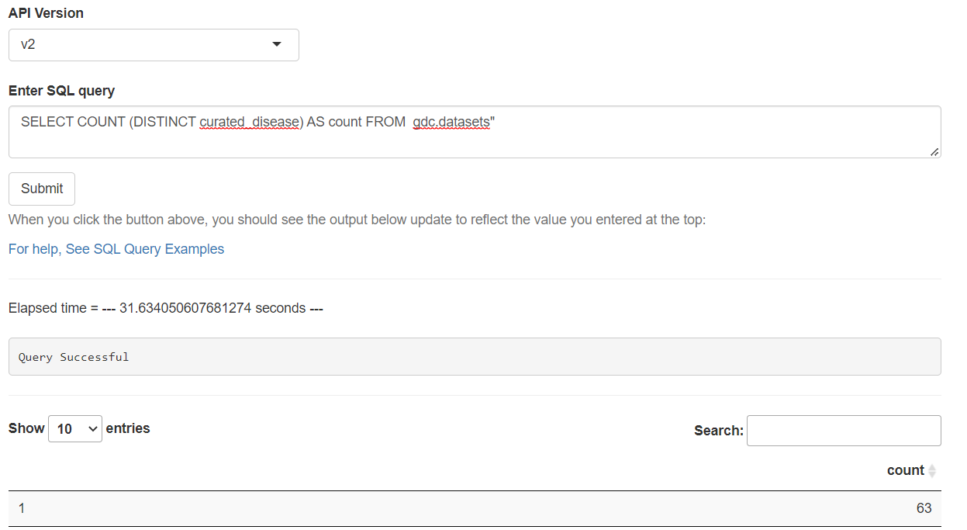
Stat Overview and Counter
With Polly Cross OA:

Slide 6
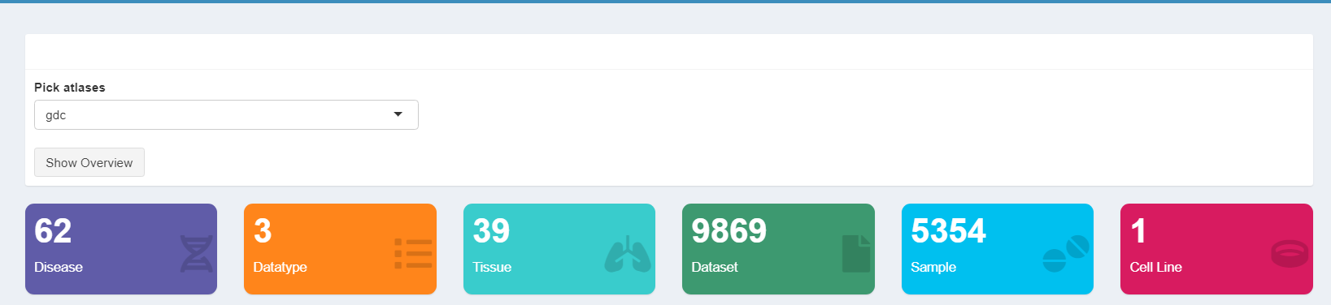
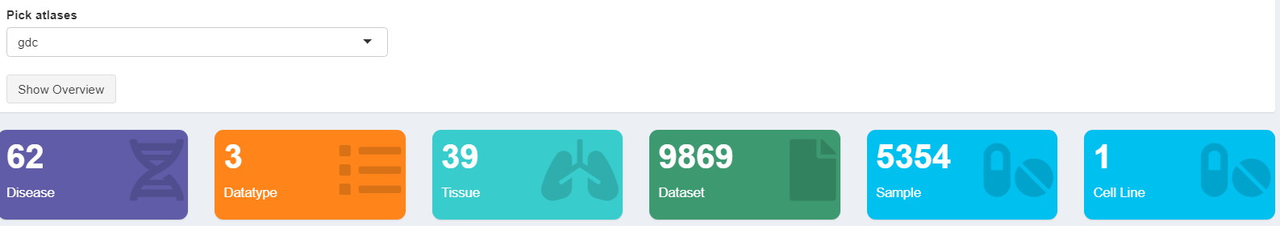
With Stat overview and counter module:
Overview for a particular atlas

Slide 7
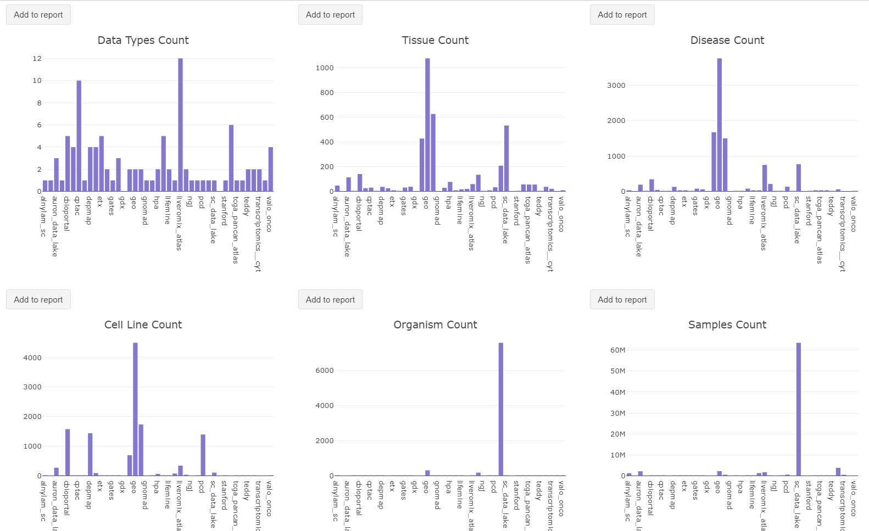
2. Overview across multiple atlases

Slide 8
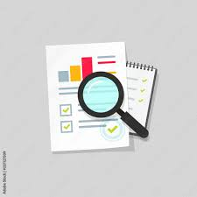
Audit module
Polly Cross OA
Prerequisite:
Familiar to SQL
Familiar to R/Python for visualization
Noah
Let’s assume, Noah wants to fetch and visualize the data available for any curated disease/curated tissue/ curated organism across multiple atlases. However, he does not accomplishes the desired prerequisite.

Slide 9
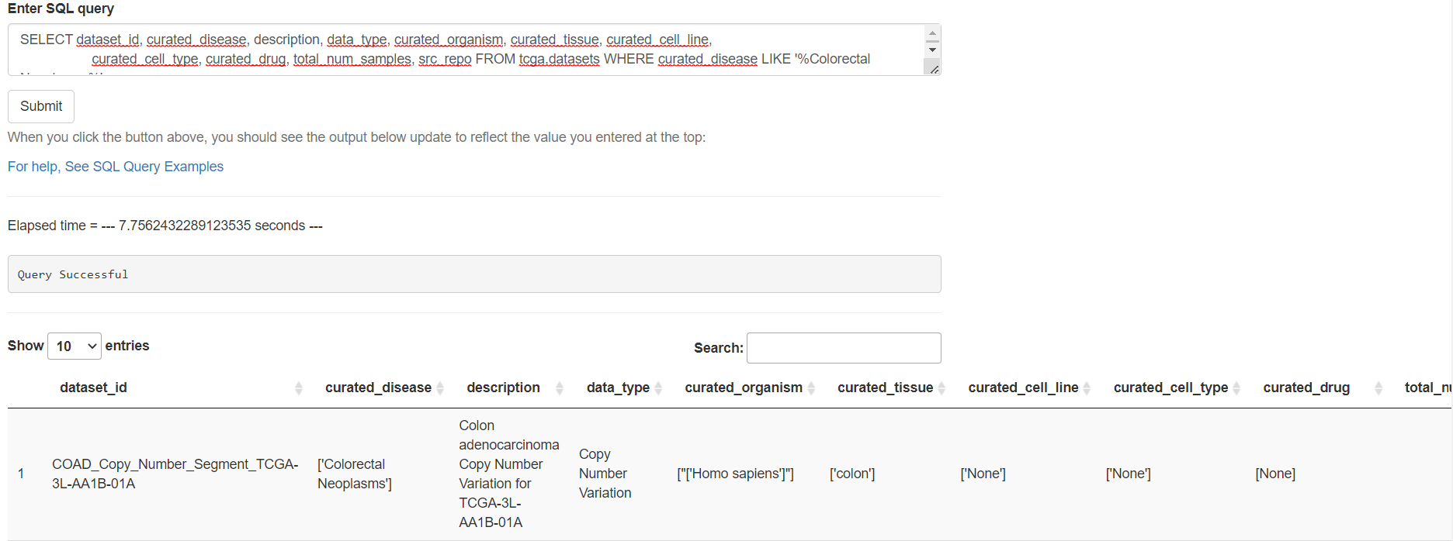
Audit module
Using Polly Cross OA:

Slide 10
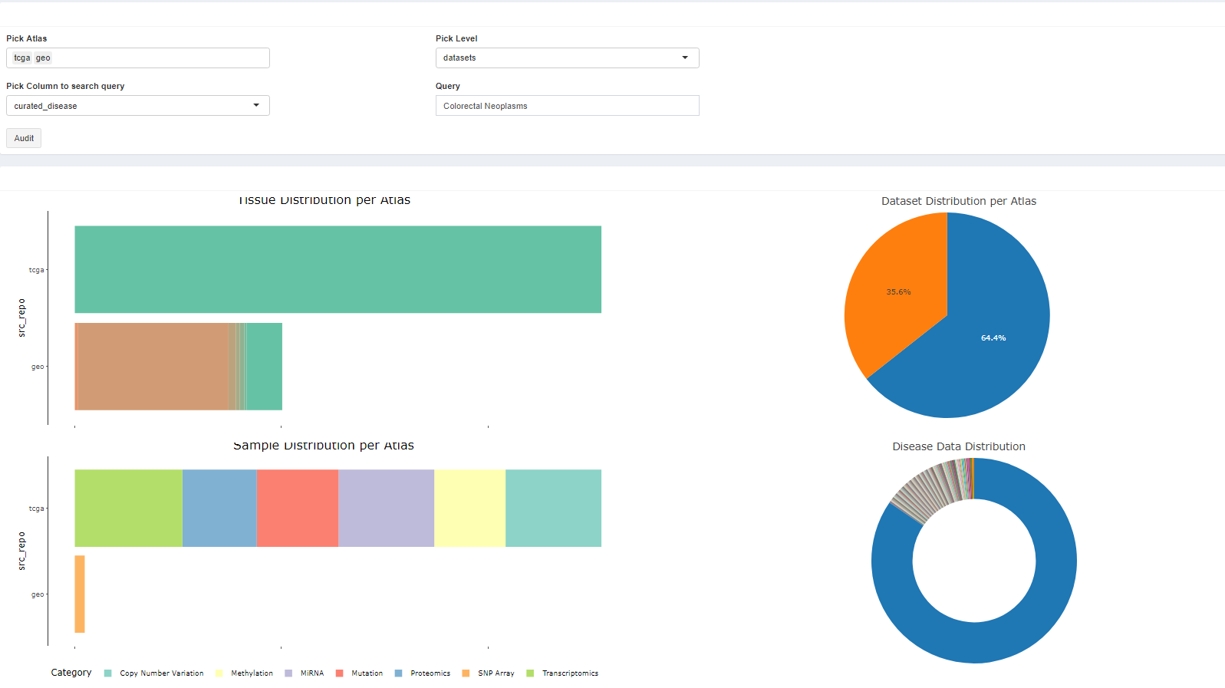
With Audit module:

Slide 11

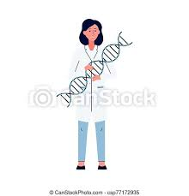
Plotter module
Polly Cross OA
Prerequisite:
Knowledge about Omix Atlas.
Familiar to SQL
Familiar to R/Python for visualization
Let’s assume, Nancy, a bioinformatician, is looking for gene information for a particular dataset from a specific atlas.
To accomplish this, Nancy can either work with Cross OA platform, or can simply access/visualize data from a single click.

Slide 12
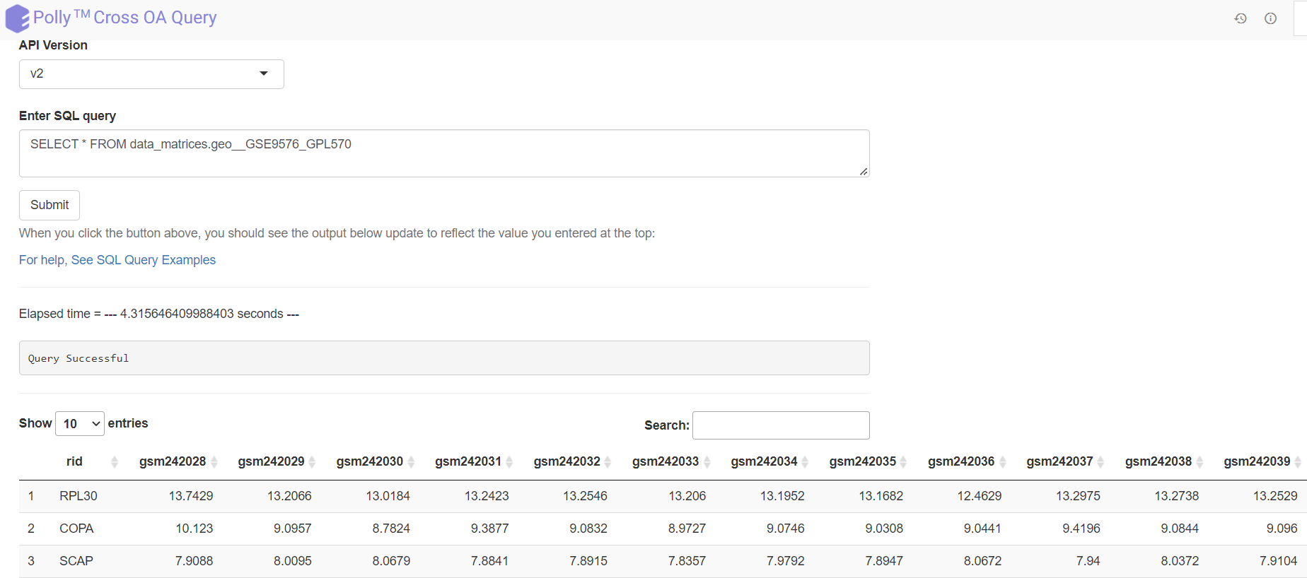
Plotter Module
With Polly Cross OA:

Slide 13
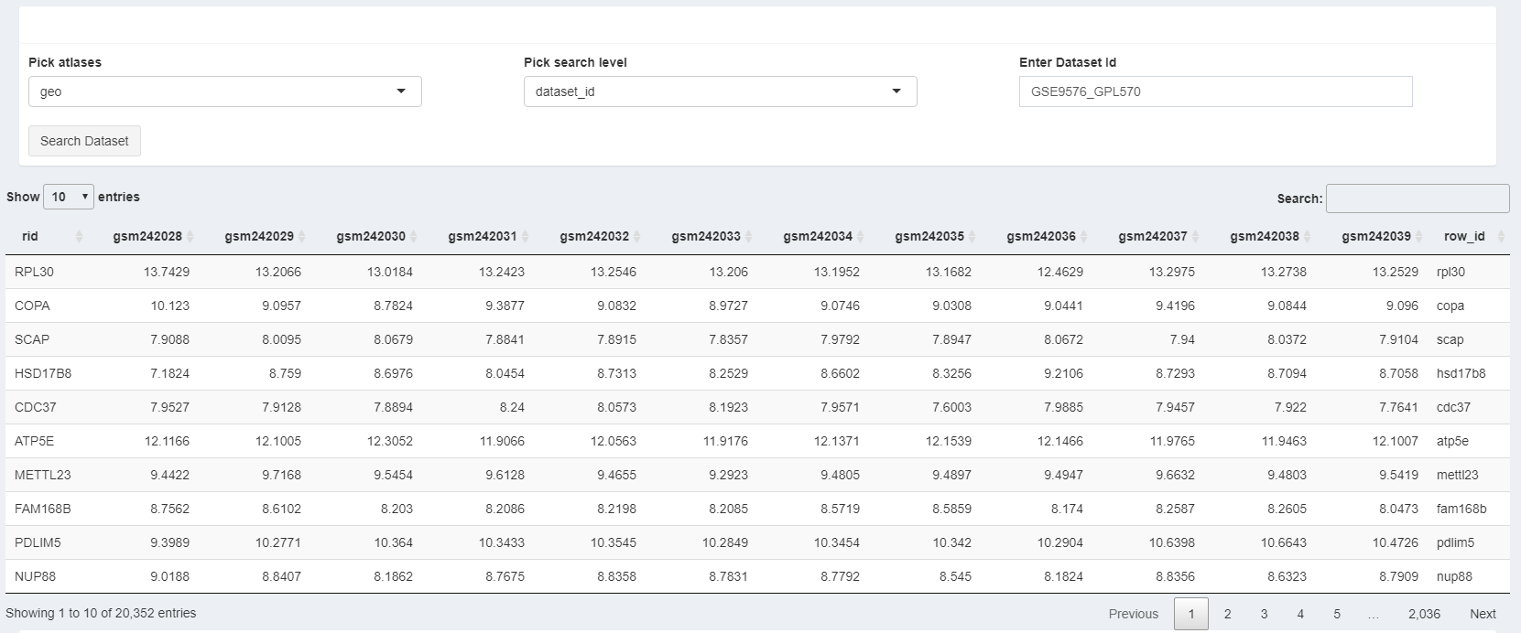
With the Plotter module:

Slide 14
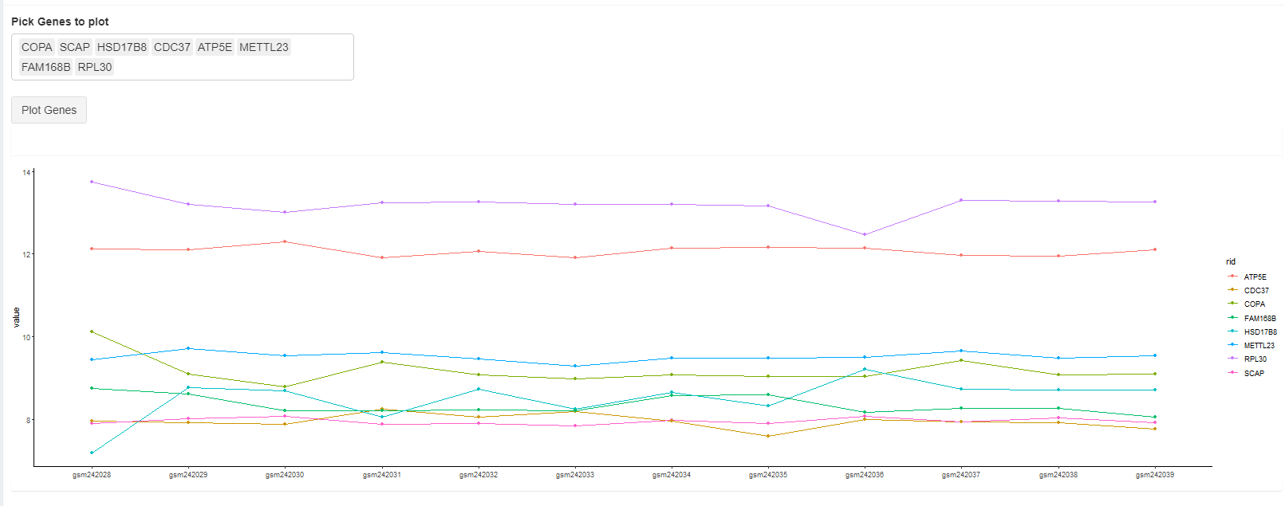
With the Plotter module:

Slide 15
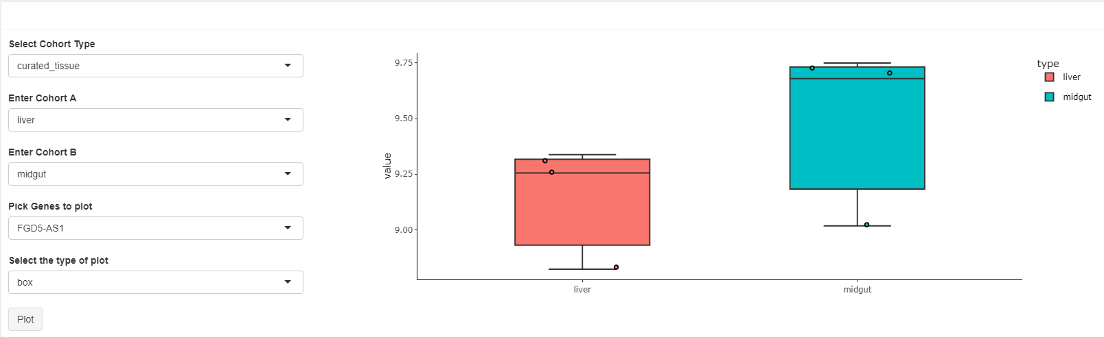
With the Plotter module:

Slide 16

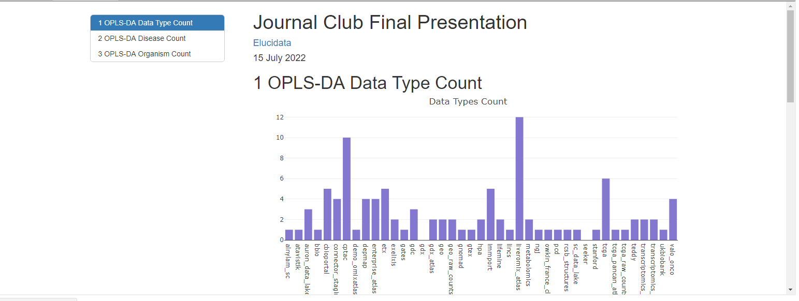
Generate Report Module
It’s time for some reports after visualizing the data

Slide 17
Acknowledgement
I would like to express my special thanks of gratitude to the entire BDA team who have helped me to complete this wonderful project, and have helped me to come across various programming skills.
Secondly, I would like to thank the entire Elucidata Family, who have provided me with such a friendly environment.

Slide 18


